Slide 1

By Charlie Phillips
Notes:
ethics

Slide 2

A safety critical system is a system whose failure may result in injury, loss of life, or serious environmental damage.
“Lives have depended on mathematical calculations for centuries”
Modern Safety-Critical systems include transportation devices like cars, trains, planes, life support systems, and power plants.
Notes:
3 mile island

Slide 3

“Highway fatalities account for more than 94% of all transportation deaths.”
modern cars have safety systems like airbags, and daytime running lights.
Systems like airbags are tested using crash tests and crash test dummies.
Notes:
GPS, Bluetooth

Slide 4

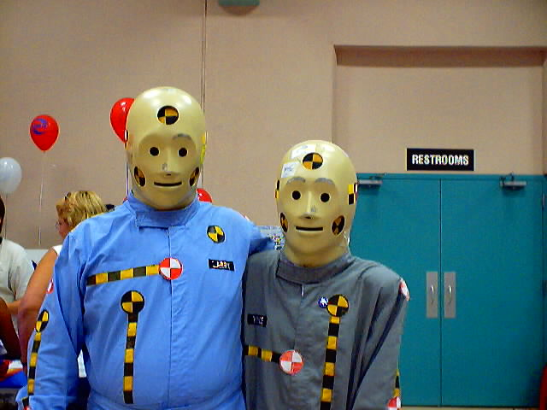
Crash test dummies
One thing used when designing new planes and space craft is a flight simulator program, and wind tunnels.
Notes:
Human cadavers. Scientists.

Slide 5
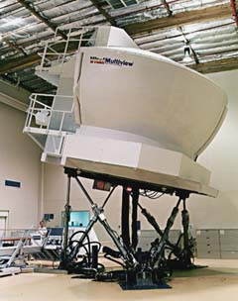
“The Advanced Concepts Flight Simulator (ACFS) is used to test planes.
This system is based on
current airplanes like the
Boeing 747, but can be
adjusted for the Space Shuttle
or new aerospace prototypes

Slide 6
the Federal Aviation Administration (FAA) required a commercial airline to spend seven weeks testing code that was only twenty thousand lines long.
Notes:
Millions of lines of code

Slide 7

Structural testing can be broken down into three parts:
Statement coverage
Branch testing
Path testing

Slide 8

This part of structural testing ensures that every statement is covered.
Makes sure there is no unreachable code.
Makes sure a line of code doesn’t crash the program.

Slide 9

This section requires us to test every branch in the code.
There are multiple ways to get through a branch.
One way may lead to unexpected errors.

Slide 10

We also must test every path through the program.
A statement can be reached from different paths.

Slide 11

Safety critical systems are expensive to make.
Statistical studies show that approximately 4 million dollars should be spent to save just one life.
Crash test dummies cost hundreds of thousands of dollars each.
The cost of fixing a defect before it is used in a real life situation is approximately ten thousand dollars.

Slide 12

We all use safety critical systems.
Testing is a big part of ensuring a safety critical system works properly.
Cost more to make, but they can save lives.
Notes:
Any questions?

